Slide 1
Clock_Synchronization_Algorithms
Lecture_14

Slide 2
Clock_Synchronization_Algorithms
If one machine has a UTC receiver, the goal becomes keeping all the other machines synchronized to it.
If no machines have UTC receivers, each machine keeps track of its own time, and the goal is to keep all the machines together as well as possible.
Each machine is assumed to have a timer that causes an interrupt, H times a second.
When this timer goes off, the interrupt handler adds 1 to a software clock that keeps track of the number of ticks (interrupts) since some agreed-upon time in the past.
Let us call the value of this clock as C.
When the UTC time is t, the value of the clock on machine p is C_{p}(t). In other words: dc/dt ideally should be 1.
Practically real timers do not interrupts exactly H times a second.
If H=60 then number of ticks per hour will be 216,000.

Slide 3
Cont..
As modern timer chips have error about 10⁻⁵, so number of ticks are 215,998 to 216,002 per hour.
If there exists some constant p, such that:
1-p <= dC/dt <=1+p
(The constant p is specified by the manufacturer and is known as maximum drift rate)

Slide 4
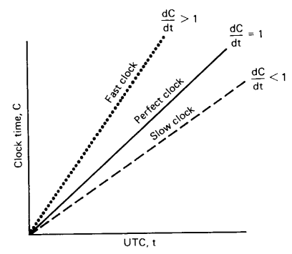
Cont..
Slow, perfect, and fast clocks are shown below:

Slide 5
Cristian’s Algorithm
One machine uses WWV receiver considered as Time server.
Goal is to have all other machines stay synchronised with the time server.
Periodically, each machine sends a request message to the time server asking it for the current time.
Time server responds as fast as it can with a message containing its current time, C_{UTC} shown in the Fig (next slide).
Let d is the estimate of delay from the time server to the sender which is also known as message propagation time.
So sender should set its clock to C_{UTC}+d

Slide 6
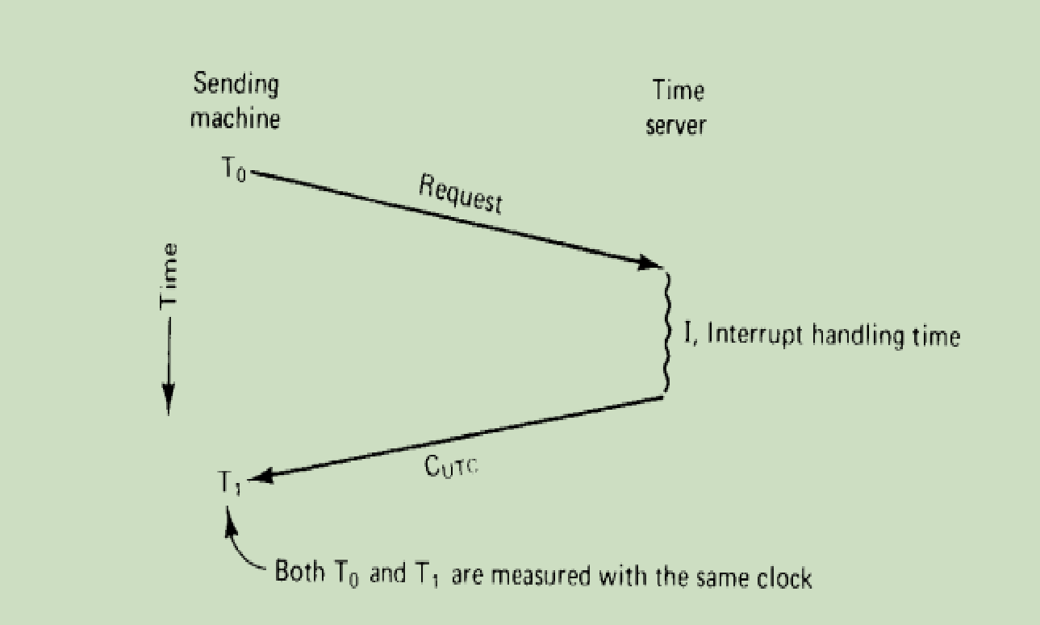
Cont..
Getting the current time from a time server:

Slide 7
Cont..
If nothing is known about I (interrupt handling time),
esimated d=(T₁-T₀)/2
where starting time T₀ and ending timeT₁
If I is known ,then estimated d=(T₁-T₀-I)/2
OR
d may be estimated using average or minimum of multiple requests.
PROBLEMS OF Cristian’s Algorithm:
When the sender gets the reply, it can just set its clock to C_{UTC}.
However, this algorithm has two problems:
The major problem is that the time must never run backward.
If the sender’s clock is fast, C_{UTC} will be smaller than the sender’s current value of C.

Slide 8
Cont..
This could cause a serious problem, such as an object file compiled just after the clock change having a timer earlier than the source which was modified just before the clock change.
Such a change must be introduced gradually. One way is as follows:
Suppose that the timer is set to generate 100 interrupts per second.
Normally, each interrupt would add 10 ms to the time. When slowing down, the interrupt routine adds only 9 ms each time, until the correction has been made.
Similarly, the clock can be advanced gradually by adding 11 ms at each interrupt instead of jumping it forward all at once.
The minor problem is that It takes a nonzero amount of time for the time server’s reply to get back to the sender. This delay may be large and vary with the network load.
SOLUTION:
Sender must record accurately the T₀ and T₁ which are measured using the same clock, so the interval will be relatively accurate.

Slide 9
Berkeley Algorithm
In Cristian’s algorithm time server is passive.
In Berkeley Algorithm time server is active known as Time Daemon.
In this case no machine has a WWV receiver.
The time server periodically gathers time data from all other machines by polling technique and based on the answers recevied, it determines the average time.
Then it communicates the average time (in fact the difference) to all machine to advance their clocks to the new time or slow their clocks down until some reduction has been achived.

Slide 10
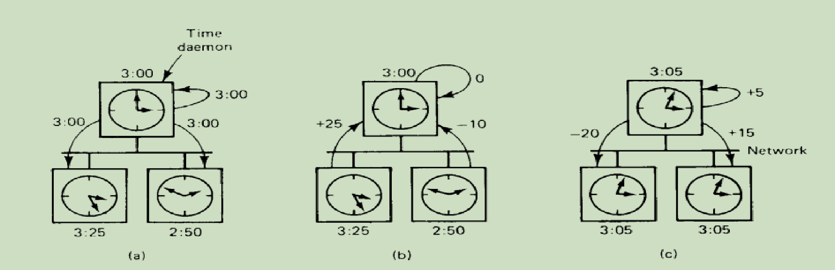
Cont..
The time daemon’s time must be set mannually by the operator periodically.
Fig. (a). The time daemon asks all other machines for their clock value.
(b). The machines answer
(c). The Time daemon tells everyone how to adjust their clock

Slide 11
Averaging Algorithms
The Cristian algorithm and the Berkeley algorithm were centralized algorithms.
Averaging algorithms are decentralized algorithms.
One class of decentralized clock synchronization algorithms works by dividing time into fixed length resynchronization intervals.
The i^{th} interval starts at T₀ + iR and runs until T₀ + (i+1)R, where, T0 is an agreed upon moment in the past, and R is a system parameter.
At the beginning of each interval, every machine broadcasts the current time according to its clock.
Then it starts a local timer to collect all other broadcasts during some interval S.
The algorithm runs to compute a new time from them by averaging the values from other machines.
Variations:
1.Discard the m highest and m lowest values and average the rest,as the extreme values consider as faulty clocks.
2. Correct each message by adding to it an estimate of the propogation time from the source.

Slide 12
Use of synchronized clocks
1. At most once message delivery:
Traditional approch:
Each messsage has a unique number and server stores all the numbers of message and can detect new messages from retransmission.
Problem:
If server crashes and reboots it loses its table of message numbers.
Modified approch(With time):
Each message carries a connection ID and timestamp.
for each connection, server records in table the most recent timestamp it has seen, if timestamp for a message is lower than the timestamp stored then the message will be rejected as a duplicate message..

Slide 13
Cont..
2. Clock based cache consistency:
It is used in distributed file system.
Traditional approch:
Each client maintains local cache which is partitioned as read and write file.
Problem:
If a client has a file cached for reading,before anather client can get a copy for writting, the the server has to first ask the reading client to invalidate its copy.
Solution: This extra overhead can be eliminated by synchronized clocks.

Slide 14
Cont..
Modified approch(With synchronized clock):
When a client wants a file,it is given a lease on it which specifies how long the copy is valid.
If the lease expires,the client can ask for it to be renewed.
If the lease expires and the file is needed again shortly then the client can ask the server if the copy it has(identified by timestamp) is still the current one then a new lease is generated,but the file need not be retransmitted.

